Slide 1
Describing tools
Área Académica: Licenciatura en Ingeniería Industrial
Profesor(a): L.E.L.I Leticia Sánchez Franco
Periodo: Enero –junio 2016

Slide 2
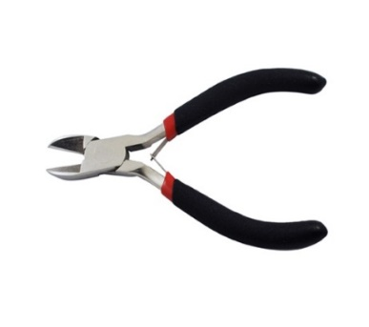
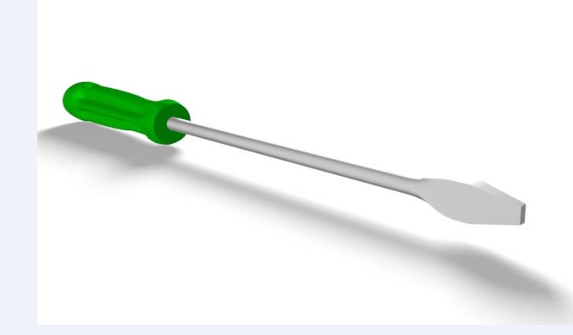
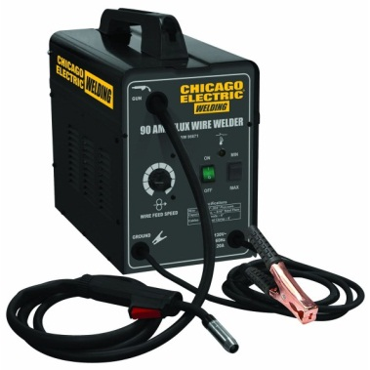
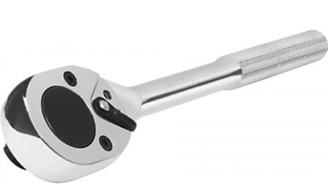
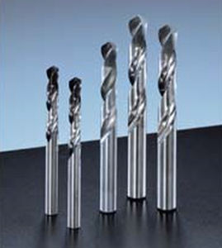
It’s something you use to cut a cable or remove part of it.
It´s a tool for turning screws.
It´s a tool for turning nuts.
Tools
It’s a machine for joining together two pieces of metal.
They are tools used to create cylindrical holes.

